Slide 1
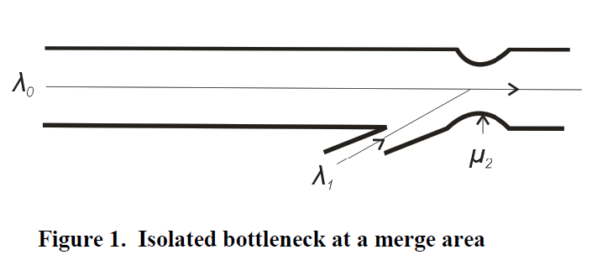
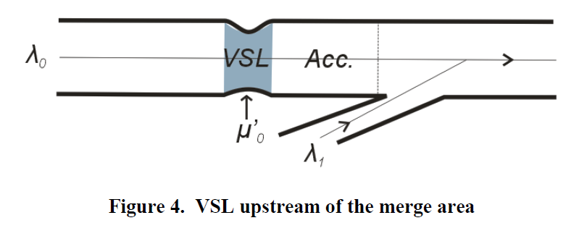
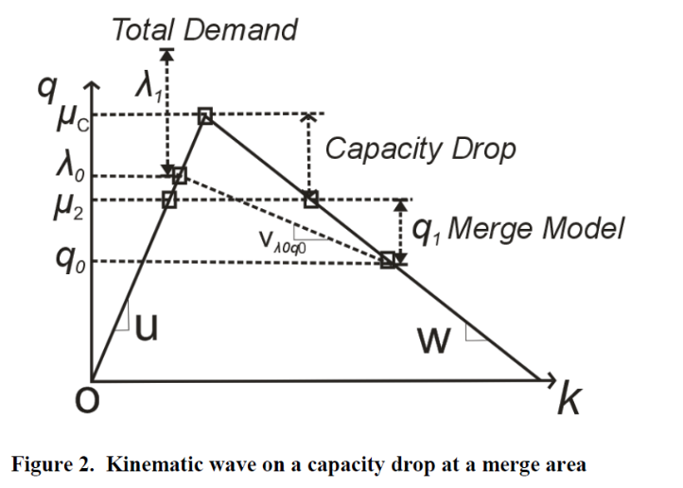
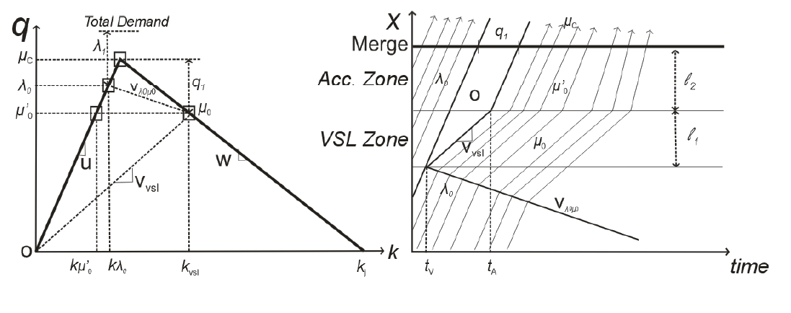

Combined Variable Speed Limits and Ramp-Metering System for Capacity Drop Control at Merge Bottleneck
Hyun Woong Cho and Jorge A. Laval
Civil & Environmental Engineering, Georgia Institute of Technology

Slide 2
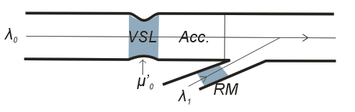
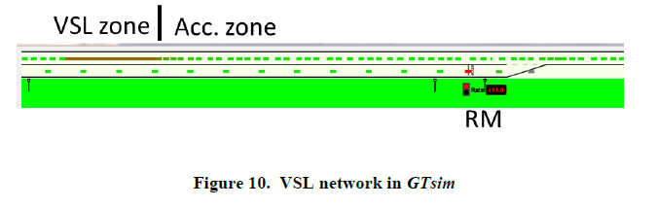
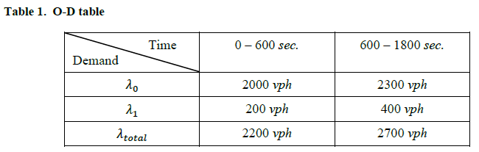
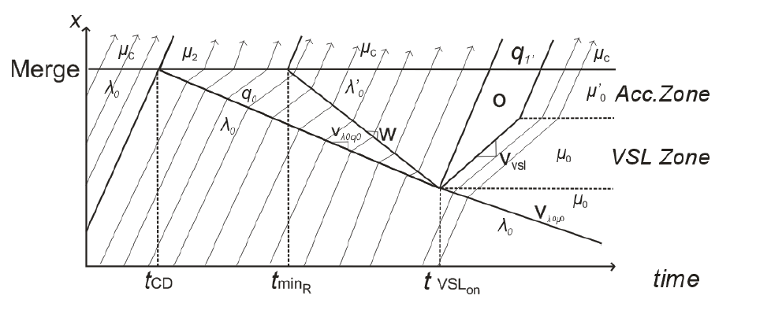
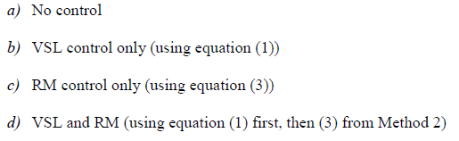
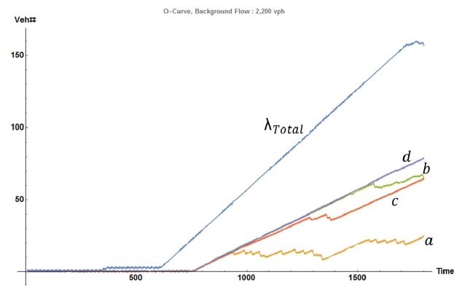
Combined Variable Speed Limits and Ramp-Metering System for Capacity Drop Control at Merge Bottleneck
Hyun Woong Cho and Jorge A. Laval
Civil & Environmental Engineering, Georgia Institute of Technology

